Slide 1
Discrete Mathematics BCSC0010
Module 1
Sets(Lecture3)

Slide 2
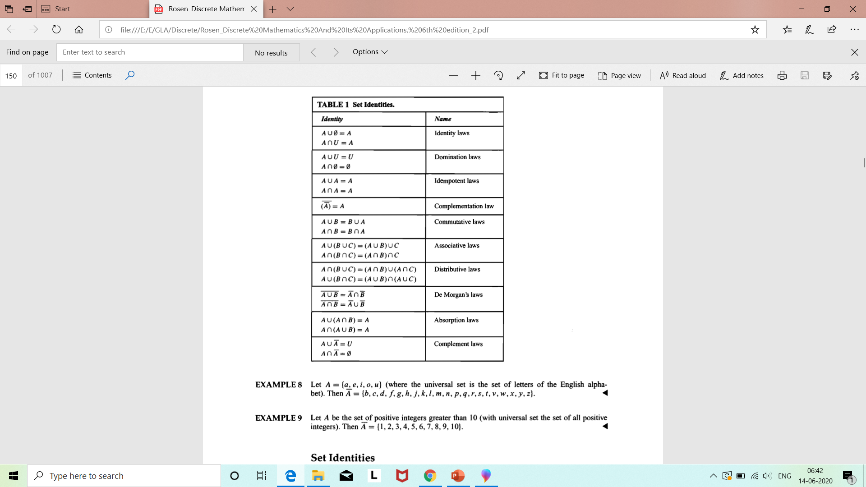
Set Identities

Slide 3
Methods to prove Set Equality
1. By Logical Equivalences
2. By Venn Diagram
3. By proving subsets of each other

Slide 4
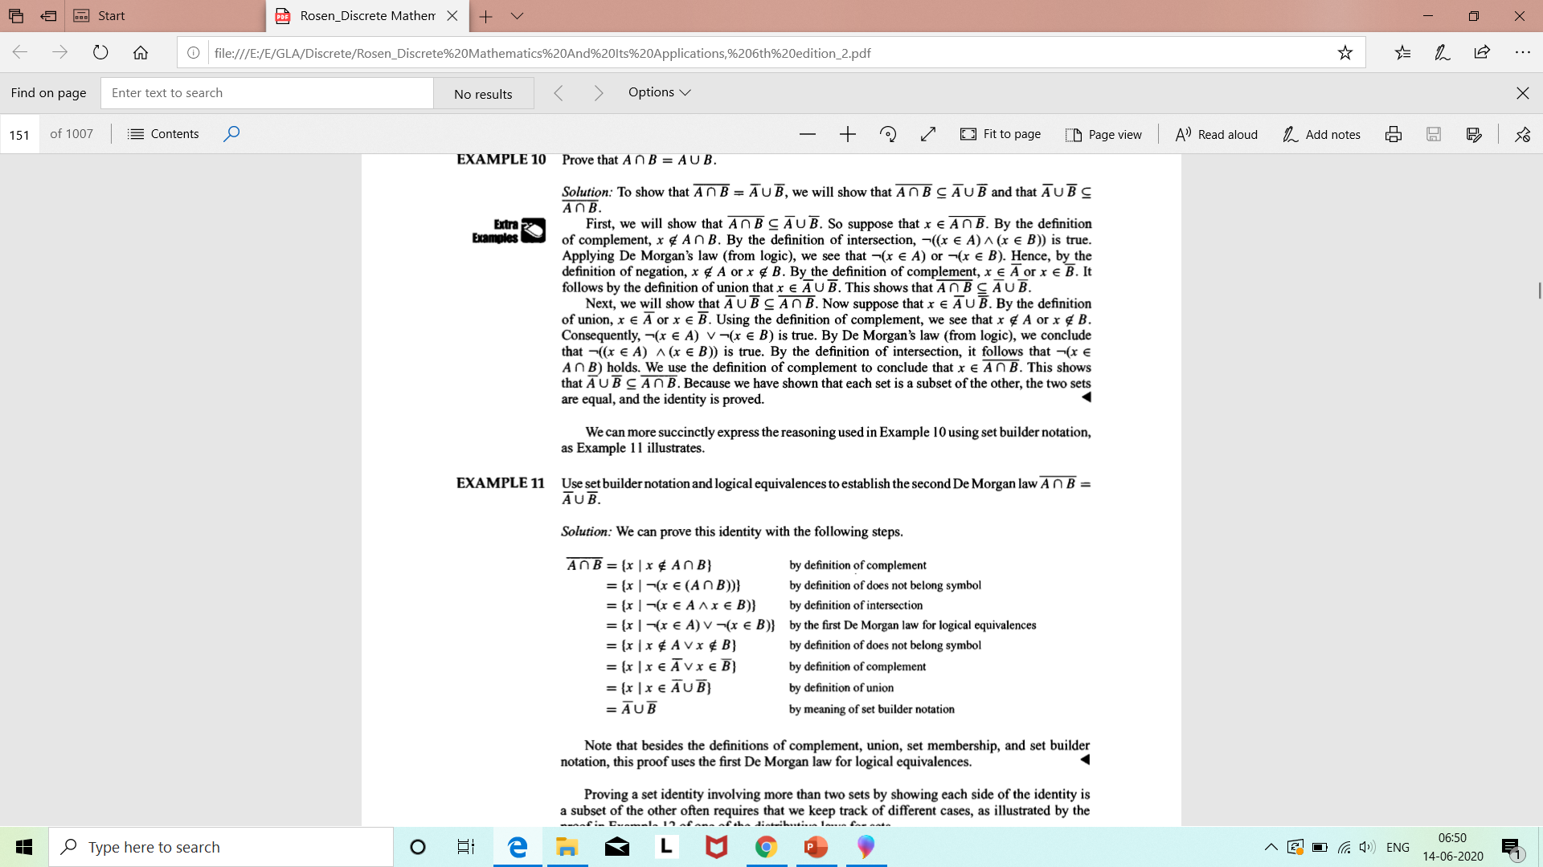
Example1 (By logical equivalences)

Slide 5
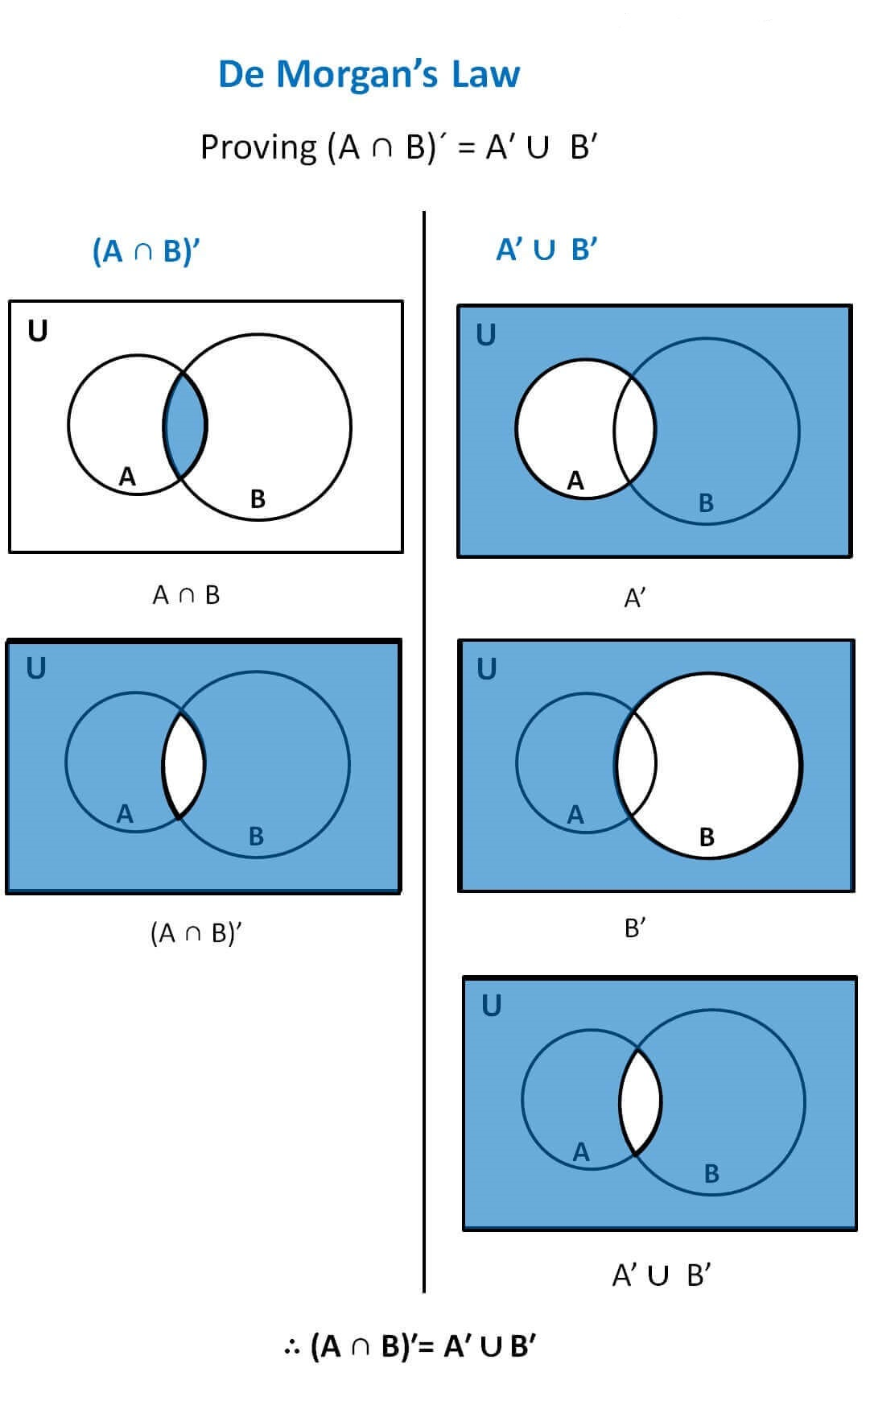
Example1 (By Venn Diagram)
Ref: https://www.teachoo.com/7038/1350/De-Morgans-Law/category/Complement-of-set/

Slide 6
Example1 (By proving
subsets of each other)
Proof of De Morgan’s law: (A U B)' = A' ∩ B'
Let P = (A U B)' and Q = A' ∩ B' Let x be an arbitrary element of P then x ∈ P ⇒ x ∈ (A U B)'
⇒ x ∉ (A U B)
⇒ x ∉ A and x ∉ B
⇒ x ∈ A' and x ∈ B'
⇒ x ∈ A' ∩ B'
⇒ x ∈ Q
Therefore, P ⊂ Q …………….. (i)
Again, let y be an arbitrary element of Q then y ∈ Q ⇒ y ∈ A' ∩ B'
⇒ y ∈ A' and y ∈ B'
⇒ y ∉ A and y ∉ B
⇒ y ∉ (A U B)
⇒ y ∈ (A U B)'
⇒ y ∈ P
Therefore, Q ⊂ P …………….. (ii)
Now combine (i) and (ii) we get; P = Q i.e. (A U B)' = A' ∩ B'

Slide 7
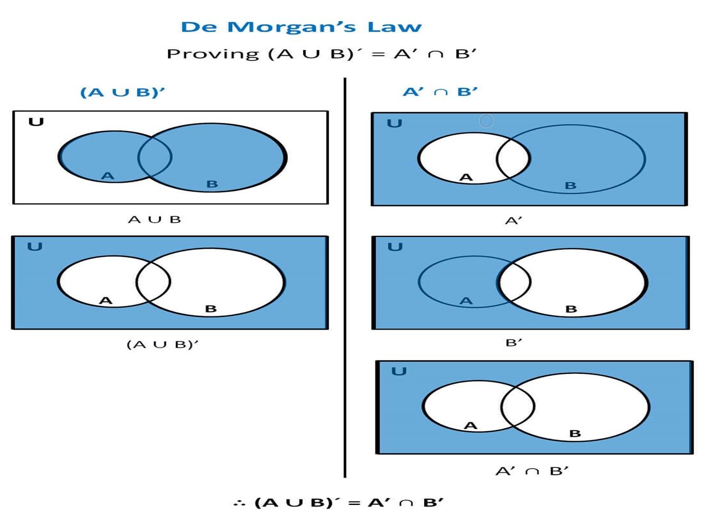
Example2 (By Venn Diagram)
Ref: https://www.teachoo.com/7038/1350/De-Morgans-Law/category/Complement-of-set/

Slide 8
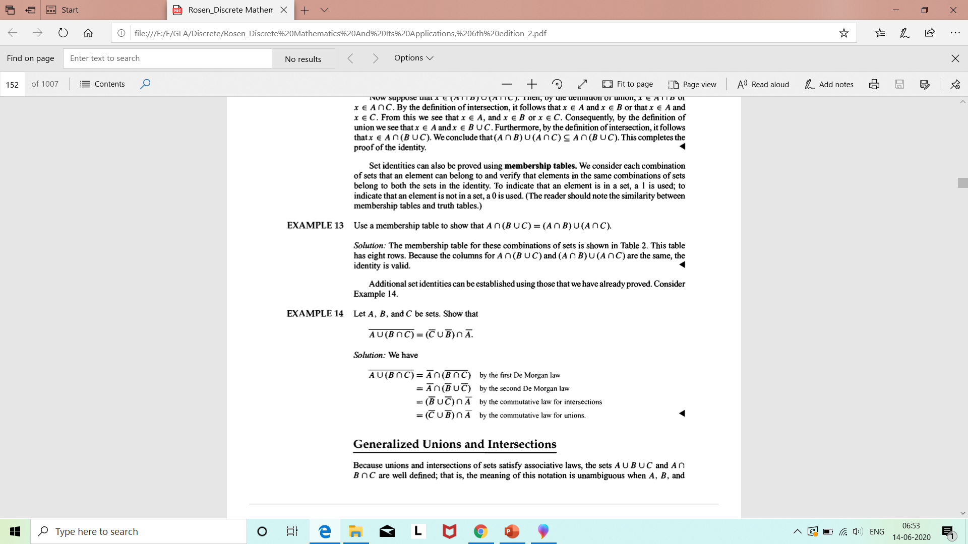
Example 3

Slide 9
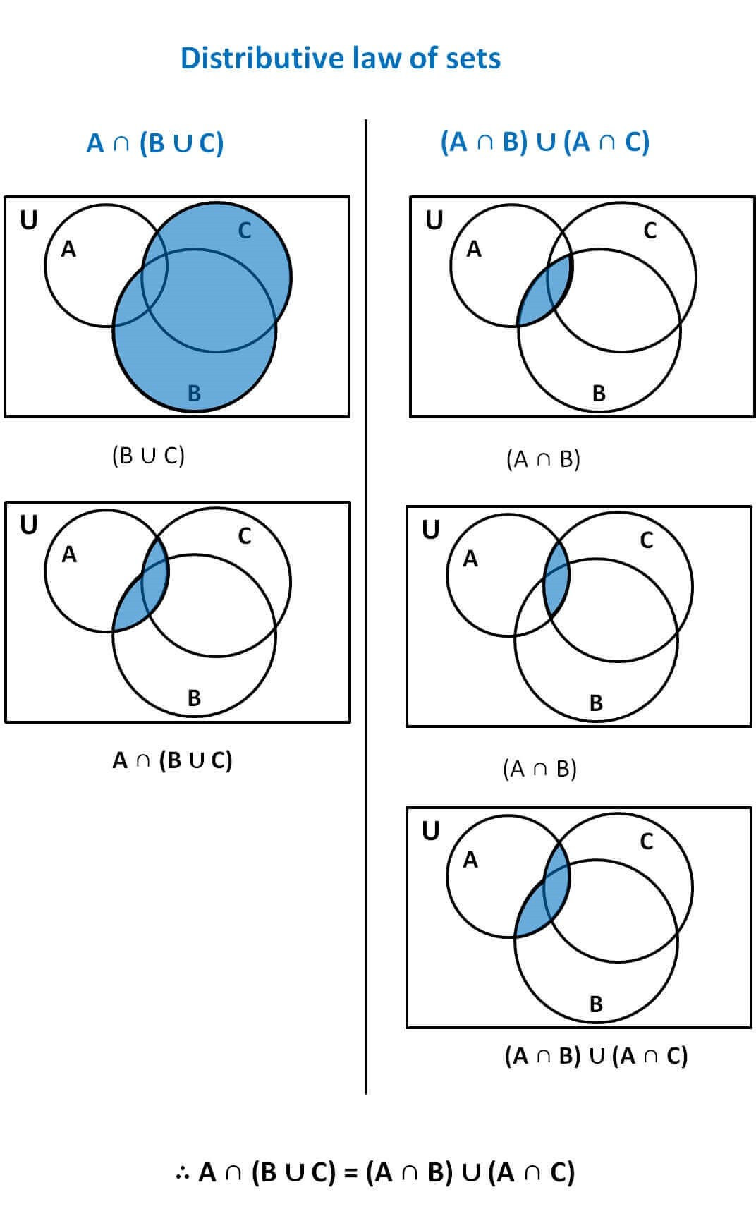
Example 4
Ref: https://www.teachoo.com/7035/1348/Proving-Distributive-law-of-sets-by-Venn-Diagram/category/Venn-Diagrams---Intersection/

Slide 10
Example 5 Show that (A – B) ∩ (C – B) = (A ∩ C) – B
Let x ∈ (A – B) ∩ (C – B)
⇒ x ∈ (A – B) and x ∈ (C – B)
⇒ (x ∈ A and x ∉ B) and (x ∈ C and x ∉ B)
⇒ (x ∈ A and x ∈ C) and x ∉ B
⇒ (x ∈ A ∩ C) and x ∉ B
⇒ x ∈ ((A ∩ C) – B )
So, (A – B) ∩ (C – B) ⊆ (A ∩ C) – B ... (1)
Contd…

Slide 11
Now, conversely
Let y ∈ (A ∩ C) – B
⇒ y ∈ (A ∩ C) and y ∉ B
⇒ (y ∈ A and y ∈ C) and (y ∉ B)
⇒ (y ∈ A and y ∉ B) and (y ∈ C and y ∉ B)
⇒ y ∈ (A – B) and y ∈ (C – B)
⇒ y ∈ (A – B) ∩ (C – B)
So, (A ∩ C) – B ⊆(A – B) ∩ (C – B) ... (2)
From (1) and (2),
(A – B) ∩ (C – B) = (A ∩ C) – B

Slide 12
Inclusion–Exclusion Principle
Suppose A and B are finite sets. Then, A ∪ B and A ∩ B are finite and
n(A ∪ B) = n(A) + n(B) − n(A ∩ B)
That is, we find the number of elements in A or B (or both) by first adding n(A) and n(B) (inclusion) and then subtracting n(A ∩ B) (exclusion) since its elements were counted twice.
We can apply this result to obtain a similar formula for three sets:

Slide 13
Inclusion–Exclusion Principle
Corollary: Suppose A, B, C are finite sets.
Then A ∪ B ∪ C is finite and
n(A ∪ B ∪ C) = n(A) + n(B) + n(C) − n(A ∩ B) − n(A ∩ C) − n(B ∩ C) + n(A ∩ B ∩ C)

Slide 14
EXAMPLE 1: In a survey of group 80 people, it is found that 60 like egg and 30 like fish. Find the people like both egg and fish.
Solution: n(E)=60
n(F)=30
n(E ∪ F)=80
n(E ∩F)=?
n(E ∪ F)=n(E)+n(F)-n(E∩F)
80=60+30- n(E∩F)
n(E∩F)=10

Slide 15
Problem based on Principle of Inclusion Exclusion |A U B| = |A| + |B| - |A ⋂ B|
Among 50 patients admitted to a hospital, 25 are diagnosed with pneumonia, 30 with bronchitis, and 10 with both pneumonia and bronchitis. Determine:
(a) The number of patients diagnosed with pneumonia or bronchitis (or both).
(b) The number of patients not diagnosed with pneumonia or bronchitis.
Solution
Let U denote the entire set of patients. Let P and B denote the set of patients diagnosed with pneumonia and bronchitis respectively. Thus:
|U| = 50, |P| = 25, |B| = 30, |P ∩ B| = 10
Contd..

Slide 16
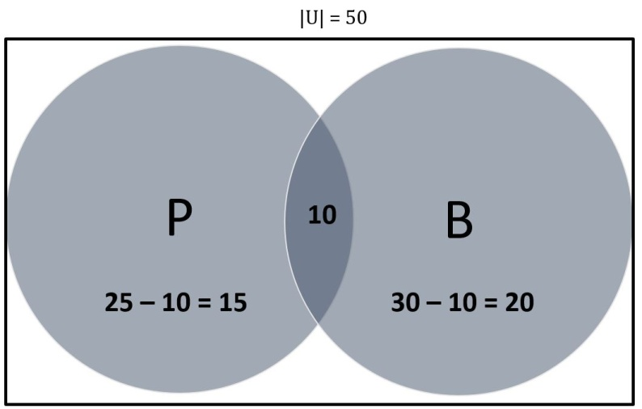
(a) By Venn Dig.,
|P ∪ B| = 15 + 10 + 20= 45
Thus 45 patients are diagnosed with pneumonia or bronchitis.
By using formula,
|P ∪ B| = |P| + |B| – |P ∪ B|
= (25 + 30) – (10) = 45
Thus 45 patients are diagnosed with pneumonia or bronchitis.
(b) |(P ∪ B)’|
= 50 – 45 = 5
5 patients are not diagnosed with pneumonia or bronchitis.

Slide 17
Problem based on Principle of Inclusion Exclusion(for 3 sets) ∣ A ∪ B ∪ C ∣ = ∣ A ∣ + ∣ B ∣ + ∣ C ∣ − ∣ A ∩ B ∣ − ∣ A ∩ C ∣ − ∣ B ∩ C ∣ + ∣ A ∩ B ∩ C ∣
A large software development company employs 100 computer programmers. Of them, 45 are proficient in Java, 30 in C#, 20 in Python, 6 in C# and Java, 1 in Java and Python, 5 in C# and Python, and just 1 programmer is proficient in all three languages above. Determine the number of computer programmers that are not proficient in any of these three languages.
Solution
Let U denote the set of all employed computer programmers and let J, C and P denote the set of programmers proficient in Java, C# and Python, respectively. Thus:
|U| = 100, |J| = 45, |C| = 30, |P| = 20, |J ∩ C| = 6, |J ∩ P| = 1, |C ∩ P| = 5, |J ∩ C ∩ P| = 1
Contd..

Slide 18
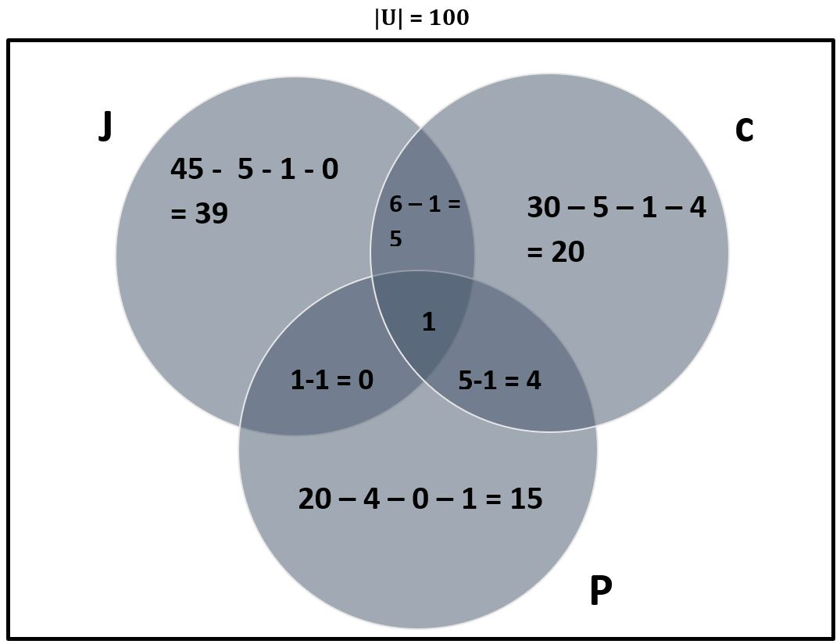
|J ∪ C ∪ P|
= 39 + 5 +20 +4 +15 + 1
= 84
Now calculate the complement:
|(J ∪ C ∪ P)’ | = |U| – |J ∪ C ∪ P|
= 100 – 84
= 16
16 programmers are not proficient in any of the three languages.

Slide 19
Partition of sets

Slide 20
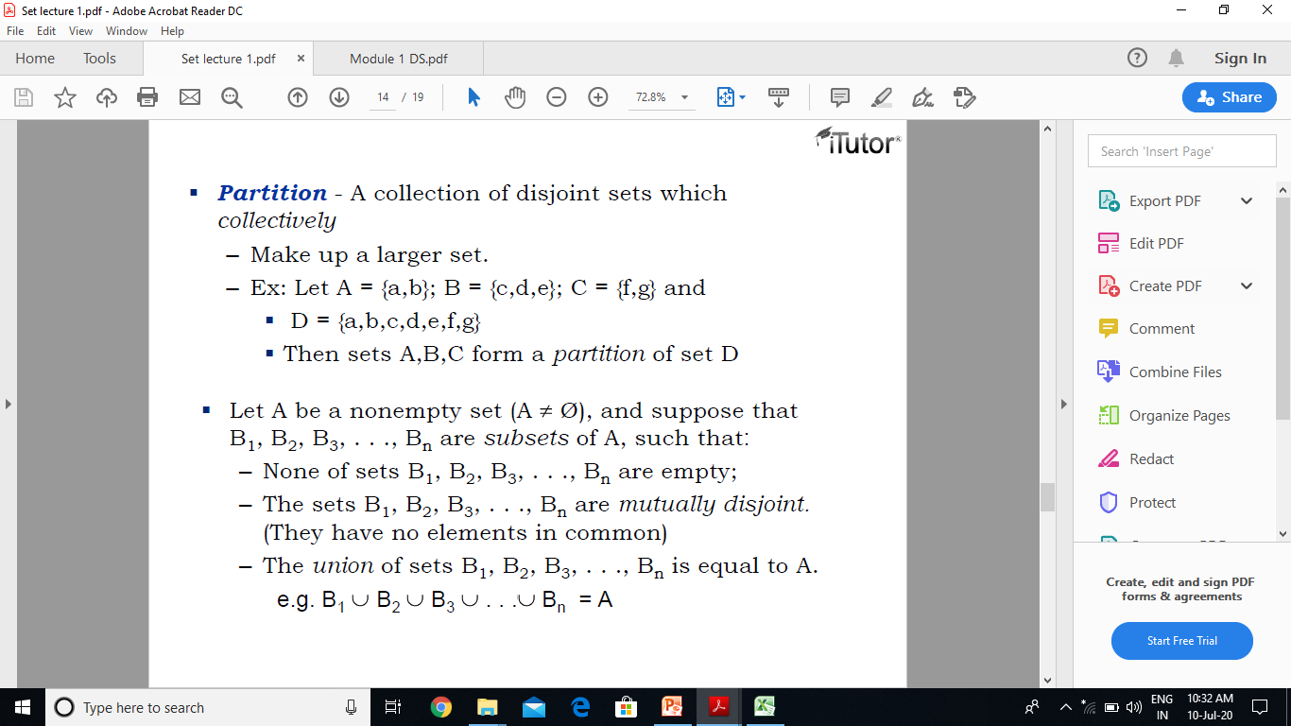

Slide 21
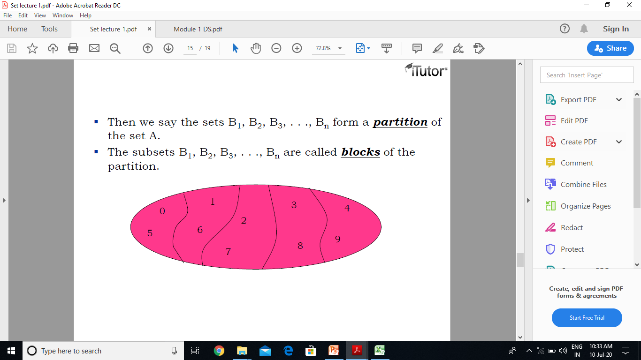
B₅
B₁
B₃
B₄
B₂

Slide 22
Partitions of Sets
Let S be a nonempty set. A partition of S is a subdivision of S into non-overlapping, non-empty subsets.
Precisely, a partition of S is a collection {A_{i}} of non-empty subsets of S such that:
(i) Each a in S belongs to one of the A_{i} .
(ii) The sets of {A_{i} } are mutually disjoint; that is,
if A_{j} = A_{k} then A_{j} ∩ A_{k} = ∅
The subsets in a partition are called cells.

Slide 23
Example of Partition of Sets
Ex 1. Consider the following collections of subsets of
S = {1, 2, . . ., 8, 9}
(i) [{1, 3, 5}, {2, 6}, {4, 8, 9}]
(ii) [{1, 3, 5}, {2, 4, 6, 8}, {5, 7, 9}]
(iii) [{1, 3, 5}, {2, 4, 6, 8}, {7, 9}]
What is/are the correct partitions of set S.
Sol: (i) is not a partition of S since 7 in S does not belong to any of the subsets. Furthermore,
(ii) is not a partition of S since {1, 3, 5} and {5, 7, 9} are not disjoint.
(iii) is a partition of S.

Slide 24
Ex. 2: Let S = {a, b, c, d, e, f , g}. Determine which of the following are partitions of S:
P1 = [{a, c, e}, {b}, {d, g}],
P2 = [{a, e, g}, {c, d}, {b, e, f }],
(c) P3 = [{a, b, e, g}, {c}, {d, f }],
(d) P4 = [{a, b, c, d, e, f , g}].
Ex 3. Find all partitions of S = {a, b, c, d}.

